Slide 1
Making this resource work for you
Prior to teaching this lesson, please refer to the ‘Unit Overview and Planning Document’.
Further guidance on planning Science Mastery lessons can be found in the detailed planning guidance document.
Refer to the ‘notes’ section on each slide for useful information, including suggested expositions, pedagogical content knowledge, suggested questions, answers and more. Consider using presenter mode so you can see this guidance throughout the lesson.
The introduction slides can be adapted to suit your teaching style and the needs of your class.
Before the lesson, adapt the fix-it slide to address any misconceptions identified in the previous lesson’s exit ticket.
Choose from the suggested activities to suit your class. The intention is not that you complete all of these, but that you select those which ones are most appropriate for your students. It may be appropriate to further adapt activities for your students.
These lessons are designed to occupy approximately 1 hour. To adapt for a shorter or longer lesson duration we advise you to adapt the activity section accordingly.
Please consider using the final slide to send feedback about this lesson or examples of PowerPoints that you have adapted to our design team. Your feedback is used to improve Science Mastery for all of our teachers and students. We appreciate all suggestions and comments.
Thank you for reading!
The Science Mastery Team

Slide 2
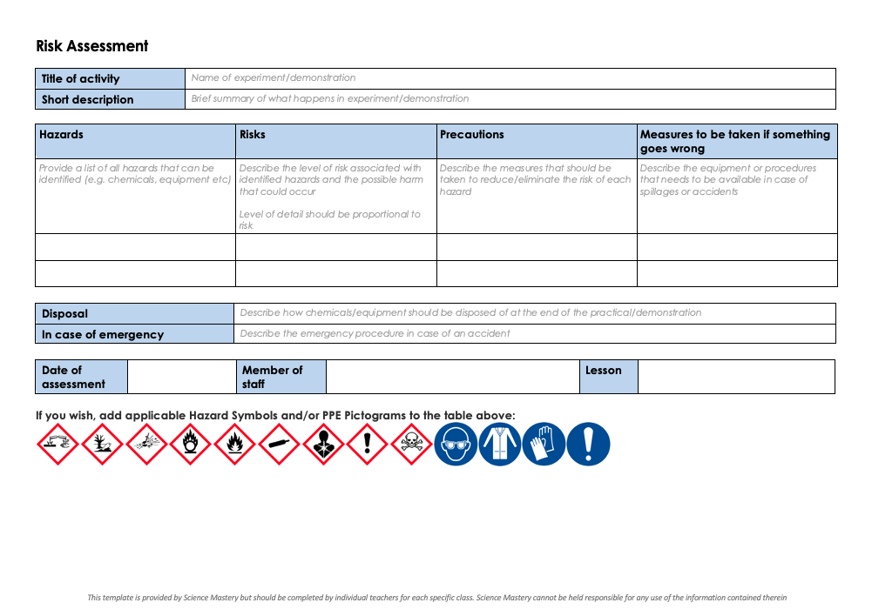
Practical Activity
This lesson contains a practical activity (either a whole class activity or a demonstration)
A risk assessment must be completed for this practical
The template risk assessment can be found here.
The risk assessment should be specific to the class involved and written only by the teaching member of staff
The risk assessment should refer to the current CLEAPSS Hazcards for all chemicals used in the practical for safety and disposal notes.
A list of chemicals used can be found in the Practical Guide
It is good practice for students to wear safety spectacles during all class practicals and demonstrations
Thank you for reading!
The Science Mastery Team

Slide 3
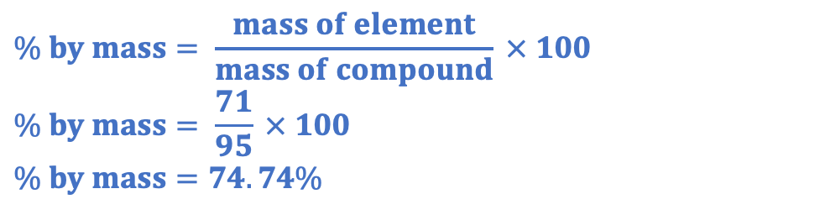
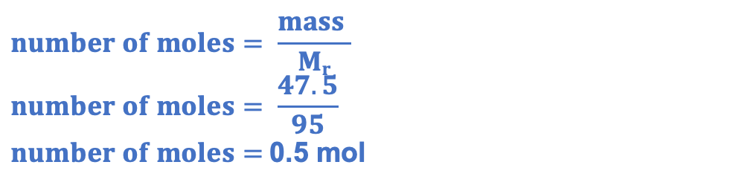
(HT) Amounts of Substances in Equations
Answer the questions below.
Define relative formula mass.
Calculate the relative formula mass of magnesium chloride (MgCl₂). Mg = 24, Cl = 35.5
Calculate the percentage by mass of chlorine in magnesium chloride.
Calculate the number of moles in 47.5 g of magnesium chloride.
The sum of the relative atomic mases in a compound (formula).
24 +(2x35.5) = 95
$$\% by mass= \frac{mass of element}{mass of compound} × 100$$
$$\% by mass= \frac{71}{95} × 100$$
$$\% by mass=74.74\%$$
$$number of moles= \frac{mass }{Mr}$$
$$number of moles= \frac{47.5}{95}$$
$number of moles=$0.5 mol
Notes:
Big idea: Reactions rearrange matter
Foundation: State how many molecules there are in one mole of oxygen.
Stretch: State how many atoms there are in one mole of oxygen.
Answers:
Foundation: 6.02 x 10²³
Stretch: Oxygen is diatomic, so 2 x 6.02 x10²³ = 1.204 x10²⁴

Slide 4
(HT) Amounts of Substances in Equations
Do Now:
Define relative formula mass.
Calculate the relative formula mass of magnesium chloride (MgCl₂). Mg = 24, Cl = 35.5
Calculate the percentage by mass of chlorine in magnesium chloride.
Calculate the number of moles in 47.5 g of magnesium chloride
Drill:
Calculate the M_{r} of potassium sulfate (K₂SO₄). K=39, S=32, O=16
Calculate the M_{r} of aluminium hydroxide (Al(OH)₃). Al=27, O=16, H=1
Calculate the M_{r} of calcium nitrate (Ca(NO₃)₂). Ca=40, N=14, O=16
Notes:
Drill answers:
174
81
164

Slide 5
(HT) Amounts of Substances in Equations
Read Now:
Chemical equations must be balanced because atoms cannot be created or destroyed in a chemical reaction, only rearranged. A balanced chemical equation shows us the ratio in which reactants react or products or made. For example, in the reaction 2H₂ + O₂ → 2H₂O, we can see that two molecules of hydrogen react with every oxygen molecule to produce two molecules of water. In real chemical equations, it would be extremely unlikely to just have a couple of molecules reacting, so instead we can use the balanced chemical equation to show us the ratio of moles that are involved. This means that 2 moles of hydrogen react with1 mole of oxygen to produce 2 moles of oxygen. Remember that 1 mole of any substance contains 6.02 x10²³ particles.
Explain why chemical equations must be balanced.
Describe the reaction between hydrogen and oxygen to form water in terms of molecules.
Describe the reaction between hydrogen and oxygen to form water in terms of moles.
State the number of particles that are present in 1 mole of a substance.

Slide 6
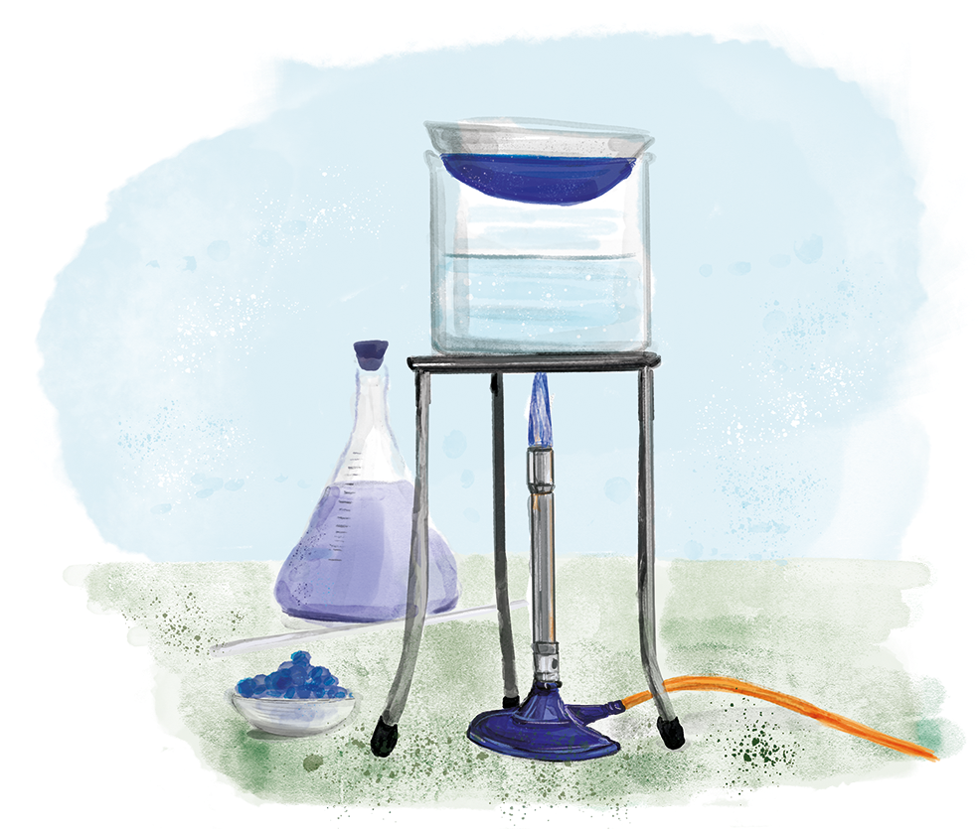
C4.3.7
15/03/2024
(HT) Amounts of Substances in Equations
C4.3.1 Prior Knowledge Review
C4.3.2 (HT) Introducing the Mole
C4.3.3 (HT) Mole Calculations
C4.3.4 PKR: Concentration
C4.3.5 TIF: Calculating Concentration
C4.3.6 TIF: Calculating an Unknown Concentration
C4.3.7 (HT) Amounts of Substances in Equations
C4.3.8 (HT) Limiting Reactants
C4.3.9 PKR: Reactions of Acids
C4.3.10 Acids, Alkalis and Neutralisation
C4.3.11 TIF: Acid-Alkali Titration
C4.3.12 TIF: Acid-Alkali Titration Analysis
C4.3.13 TIF: Titration Calculations
C4.3.14 (HT) Strong and Weak Acids
C4.3.15 TIF: Volumes of Gases
Notes:
Big idea: Reactions rearrange matter
In this lesson students will learn how to calculate the amount of substance in chemical equations. This is higher tier content, building on the knowledge from L2 and L3 of this unit and the relationship between number of moles, mass and relative formula mass. In the following lesson, they will look at this in terms of limiting reactants. Students will then revisit this part of quantitative chemistry in C4.4, where they will cover percentage yield and atom economy.
Suggested Hook:
What is a mole? How many particles are there in 1 mole?

Slide 7

Following this lesson, students will be able to:
Describe chemical reactions in terms of number of moles
Calculate number of moles in reactions
Calculate masses of reactants or products from balanced symbol equations
Key Words:
mass
moles
M_{r}
mole ratio
Notes:
Guidance:
See unit overview document and planning guidance to see how these objectives are typically assessed at GCSE, including examples of what students should be able to do following this lesson.
Planning for different needs:
The learning objectives given on this slide are suggested based on the most common requirements for exams, however they can be adapted based on the needs of different classes.
For best practice, the unit preparation booklet should be used to determine the appropriate focus of lessons within the unit.
While it is not possible to explicitly split content into levelled grades, we recommend that lesson objectives can be classified as critical, core or stretch.
Critical: the content or skill is essential for all students to be able to progress.
Core: the content or skill is important for students to progress, but other opportunities may be available to revisit it.
Stretch: the content or skill may not be essential for all students but is important for students aiming for the highest grades.
Key skill: this is a crucial skill being developed in this unit as part of the skill mapping
C4.3.7 Lesson Objectives:
Critical: Describe chemical reactions in terms of number of moles
Critical: Calculate number of moles in reactions
Core: Calculate masses of reactants or products from balanced symbol equations

Slide 8
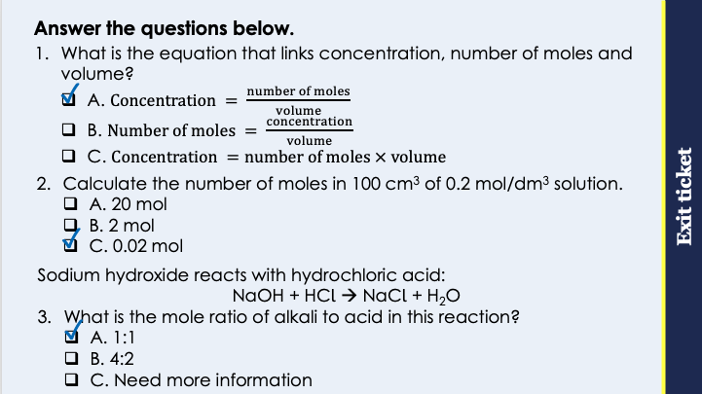
This is the fix-it portion of the lesson
The fix-it is an opportunity to respond to gaps in knowledge, especially those identified by the pre-unit quiz.
The teacher should customise this slide as needed, to facilitate
reteach, explanation, demonstration or modelling of ideas and concepts that students have not yet grasped or have misunderstood.
practise answering specific questions or of key skills.
redrafting or improving previous work.
Notes:
Purpose: to spend time on any gaps identified in previous learning from exit ticket.
Fix-it guidance from previous exit ticket:
Q1. Answer: A
If students answer B or C, it suggests they are not clear on equation that links concentration, number of moles and volume. To fix it, review the equation and the units for each quantity, showing how the units for concentration can be derived from the equation.
Q2. Answer: C
If students answer A, they have not converted from cm3 to dm3. If students answer B, they have divided concentration by volume. To fix it, remind the student of the correct formula to calculate concentration. Model the method to work this calculation out, and then give the student some similar calculations to try.
Q3. Answer: A
If students answer B, they have confused the number of atoms in the formula for each with the meaning of (or lack of) coefficients. If students answer C, they have not realised the relationship between the coefficients and the mole ratio. This will be addressed again in the next lesson. To fix it, give students more practice of calculations where they have to first identify the mole ratio.

Slide 9
Mole Ratios
What does this mean in terms of moles?
4 K + O₂ → 2 K₂O
1 mol
0.25 mol
0.5 mol
12 mol
3 mol
6 mol
0.2 mol
0.05 mol
0.1 mol
4 moles of potassium reacts with 1 mole of oxygen to produce 2 moles of potassium oxide.
Notes:
Suggested exposition:
When we look at a chemical equation, the first thing we need to check is that it is balanced. Remember the law of conservation of mass: atoms cannot be created or destroyed in a chemical reaction, only rearranged. This means that we always need to have the same number of atoms on the reactants side and the products side of a chemical equation.
What does the balanced chemical equation tell us?
It tells us the ratio in which reactants react and products are made.
Let’s look at this as an example. 4 K + O2 → 2 K2O
In terms of atoms, this means that 4 potassium atoms react with two oxygen atoms to make two units of potassium oxide. They would not be molecules because they would be ionically bonded. In chemical equations, it would be extremely unlikely for us to just have two or four or even a hundred atoms reacting. We can use these ratios instead to think about the number of moles reacting.
How many particles are in a mole?
6.02 x 10²³.
Remember this can be atoms, molecules, ions or particles.
So we can describe this balanced chemical equation in terms of moles, as this is more realistic concerning the number of particles that will be reacting.
4 moles of potassium reacts with 1 mole of oxygen to produce 2 moles of potassium oxide.
What if we have different numbers of moles? The reactants and products will still be in the same ratios.
What if we only have 1 mole of potassium?
The ratio of potassium to oxygen is 4:1, so there is only 1/4 as much oxygen as potassium: 0.25 mol.
What about potassium oxide?
The ratio of potassium to potassium oxide is 4:2, so there is 1/2 as much potassium oxide as potassium: 0.5 mol.
We can use this method if we have a number of moles of oxygen or potassium oxide.
If we have 3 moles of oxygen, how many moles of potassium would there be?
4 x as much, so 12 moles.
How many moles of potassium oxide?
2 x as much, so 6 moles
If we know that 0.1 moles of potassium oxide is produced, how many moles of potassium would have reacted?
2 x as much, so 0.2 moles.
How many moles of oxygen?
1/2 x as much, so 0.05 moles.
We can use these mole ratios to work out the amount of substances involved in the equation.

Slide 10
Complete the tables to show the mole ratios
N₂ + 3 H₂ → 2 NH₃
1 mol
3 mol
2 mol
0.2 mol
0.6 mol
0.4 mol
0.05 mol
0.15 mol
0.1 mol
3 C + 2 Fe₂O₃ → 4 Fe + 3 CO₂
3 mol
2 mol
4 mol
3 mol
0.75 mol
0.5 mol
1.0 mol
0.75 mol
0.075 mol
0.05 mol
0.1 mol
0.075 mol

Slide 11
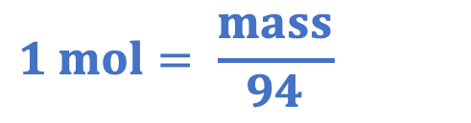
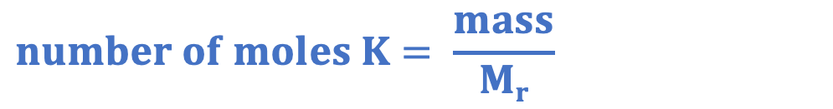
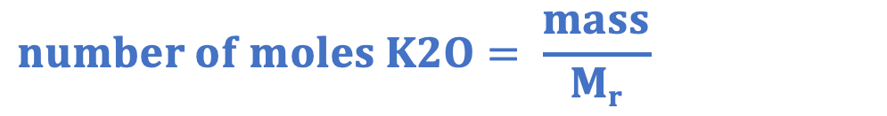
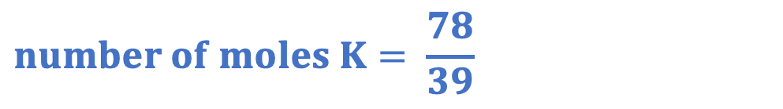
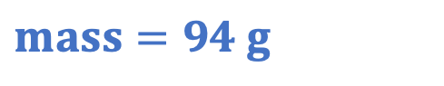
Moles, Mass and M_{r}
If we have a mass, we can calculate number of moles.
4 K + O₂ → 2 K₂O
Calculate the mass of potassium oxide that can be made from 78 g of potassium.
mole ratio = 4 : 2
mole ratio = 2 : 1
$$number of moles K2O=1 mol$$
$$number of moles K= \frac{mass}{Mr}$$
$$number of moles K2O= \frac{mass}{Mr}$$
$$number of moles K= \frac{78}{39}$$
$$1 mol= \frac{mass}{94}$$
$$number of moles K=2 mol$$
$$mass=94 g$$
Notes:
Suggested exposition:
We know from lesson 3 that we can calculate how many moles of a substance are present if we are given a mass in grams.
What is the equation that links number of moles, mass and relative formula mass (Mr)?
Number of moles = mass/Mr
What is relative formula mass? Where can we find that?
The sum of the relative atomic masses of the elements in a compound/formula. Relative atomic masses are given in the periodic table.
This means that if we have a mass in grams, we can calculate the number of moles present because we can always calculate Mr if we know the chemical formula.
Let’s do an example.
Calculate the mass of potassium oxide that can be made from 78 g of potassium.
As with any calculation, we can first identify the values that we are given. 78 g is the mass in grams.
What else can we get from the chemical equation?
The Mr. For potassium this is 39.
We can use the mass in grams and the Mr to calculate the number of moles of potassium that would have reacted.
This gives us 2 mol of potassium.
If 2 mol of potassium reacted, how many moles of potassium oxide would have been made?
4:2 ratio, which can be simplified to 2:1.
How many moles of potassium oxide would have been made?
1 mol.
We can now use this number of moles and the Mr of potassium oxide to find the mass of potassium oxide that would have been made.
What is the Mr of potassium oxide?
(39x2)+16 = 94
We can substitute this into the equation, giving us a mass in grams of 94 g of potassium oxide.
We could also use the same method to find the mass of oxygen that reacted, but this time the question is not asking us this.

Slide 12
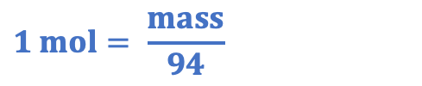
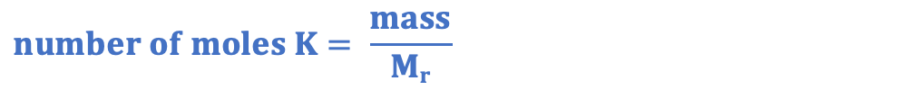
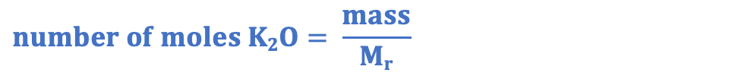
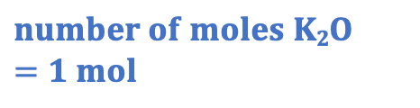
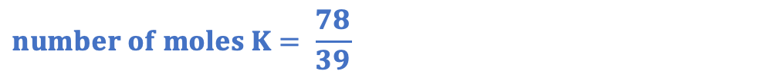
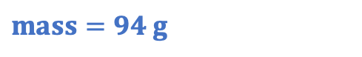
Moles, Mass and M_{r}
If we have a mass, we can calculate number of moles.
4 K + O₂ → 2 K₂O
Calculate the mass of potassium oxide that can be made from 78 g of potassium.
Formula | K | K₂O
Mole Ratio
Mr
Mass
moles
2 1
39 94
78 g ?
$$1 mol= \frac{mass}{94}$$
$$number of moles K2O= \frac{mass}{Mr}$$
$$mass=94 g$$
$$number of moles K= \frac{mass}{Mr}$$
$$number of moles K2O=1 mol$$
$$number of moles K= \frac{78}{39}$$
$$number of moles K=2 mol$$
Notes:
This table method can be used to support students with a clear structure.

Slide 13

Is this statement correct?
4 K + O₂ → 2 K₂O
4 g of potassium reacts with 1 g of oxygen to produce 2 g of potassium oxide
Notes:
This is not correct. The coefficients in the balanced equation show the mole ratio. This is not the same as the mass in grams, as 1 mole of each different substance would have a different mass.
Suggested guidance:
Talk tasks can be used in a variety of ways to suit the particular needs of the students you are teaching. Through exchanging views with others, students develop their understanding of the science beyond what could be achieved individually.
Science classrooms that successfully integrate talk have the following features:
Science talk is a regular feature of lessons and is woven into classroom activities.
Students are paired or grouped strategically by the teacher to ensure productive interaction. This might take into consideration the students’ proficiency of the English language, how encouraging they might be to peers and their attainment in the topic. It’s a good idea to consider these pairings in the class seating plan.
Students are encouraged and supported to talk, but are not forced to talk.
The teacher should take on the role of a facilitator, engaging with conversations where necessary and encouraging or steering the conversation where needed.
Students are encouraged to use the language they have to express their ideas (e.g., everyday language, imperfect English, native language), but also to incorporate science specific terminology where this is more accurate or has been taught.
6. Scientifically inaccurate ideas are not dismissed by the partner or teacher; open discussion and further investigation are relied on to help students construct ideas that support them to progress in their scientific understanding.
7. Guidelines for behaviour during talk tasks are explicit and frequently reviewed. Rules for students might be:
Listen carefully to your partner
Take turns talking.
Speak one at a time, without interrupting.
Politely agree or disagree and explain why.
Politely point out if your partner has used a scientific word incorrectly, if they have explained the science incorrectly, or if there is a more accurate way to describe something.
If confused, ask questions.
Stay focused on the discussion topic.
Respond to one another.

Slide 14
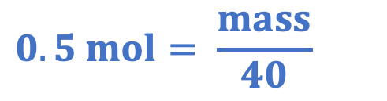
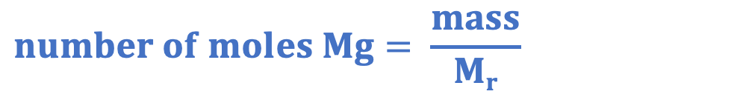
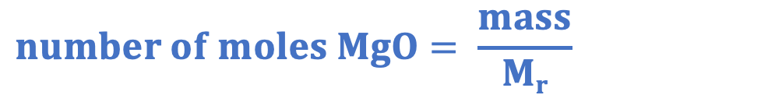
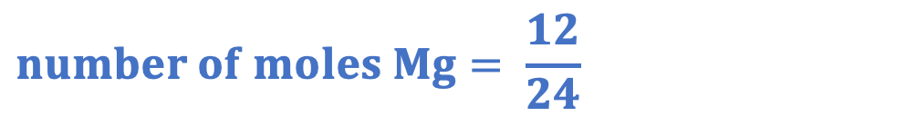
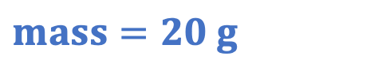
Describe how you would solve this question.
2 Mg + O₂ → 2 MgO
Calculate the mass of magnesium oxide that could be made from reacting 12 g of magnesium with oxygen.
mole ratio = 2 : 2
mole ratio = 1: 1
$$number of moles MgO=0.5 mol$$
$$number of moles Mg= \frac{mass}{Mr}$$
$$number of moles MgO= \frac{mass}{Mr}$$
$$number of moles Mg= \frac{12}{24}$$
$$0.5 mol= \frac{mass}{40}$$
$$number of moles Mg=0.5 mol$$
$$mass=20 g$$
Notes:
This can be used to get students to try and describe the steps involved in the calculation. More worked example practice is given in the I/We/You cycle.
Suggested guidance:
Talk tasks can be used in a variety of ways to suit the particular needs of the students you are teaching. Through exchanging views with others, students develop their understanding of the science beyond what could be achieved individually.
Science classrooms that successfully integrate talk have the following features:
Science talk is a regular feature of lessons and is woven into classroom activities.
Students are paired or grouped strategically by the teacher to ensure productive interaction. This might take into consideration the students’ proficiency of the English language, how encouraging they might be to peers and their attainment in the topic. It’s a good idea to consider these pairings in the class seating plan.
Students are encouraged and supported to talk, but are not forced to talk.
The teacher should take on the role of a facilitator, engaging with conversations where necessary and encouraging or steering the conversation where needed.
Students are encouraged to use the language they have to express their ideas (e.g., everyday language, imperfect English, native language), but also to incorporate science specific terminology where this is more accurate or has been taught.
6. Scientifically inaccurate ideas are not dismissed by the partner or teacher; open discussion and further investigation are relied on to help students construct ideas that support them to progress in their scientific understanding.
7. Guidelines for behaviour during talk tasks are explicit and frequently reviewed. Rules for students might be:
Listen carefully to your partner
Take turns talking.
Speak one at a time, without interrupting.
Politely agree or disagree and explain why.
Politely point out if your partner has used a scientific word incorrectly, if they have explained the science incorrectly, or if there is a more accurate way to describe something.
If confused, ask questions.
Stay focused on the discussion topic.
Respond to one another.

Slide 15
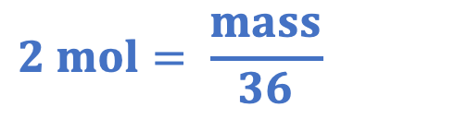
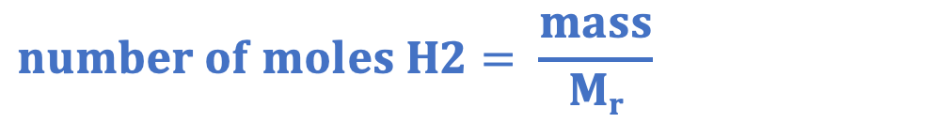
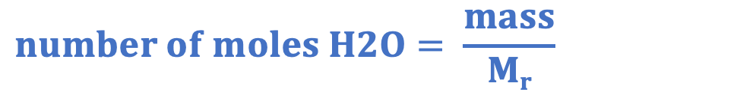
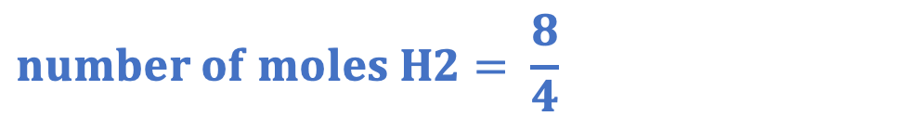
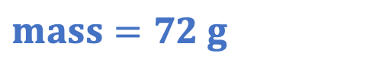
Identify the mistake(s) in this working.
2 H₂ + O₂ → 2 H₂O
Calculate the mass of water that could be made from reacting 8 g of hydrogen with oxygen.
mole ratio = 2 : 2
mole ratio = 1: 1
$$number of moles H2O=2 mol$$
$$number of moles H2= \frac{mass}{Mr}$$
$$number of moles H2O= \frac{mass}{Mr}$$
$$number of moles H2= \frac{8}{4}$$
$$2 mol= \frac{mass}{36}$$
$$mass=72 g$$
$$number of moles H2=2 mol$$
Notes:
This is a common mistake, where students use the coefficients in the Mr calculations. This is another possible method, but in this case the mole ratio has effectively been used twice, making the answer actually correct, but the working wrong. In this case, the student would get a maximum of 2/4.

Slide 16
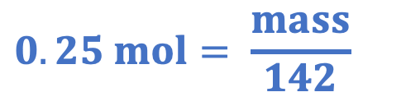
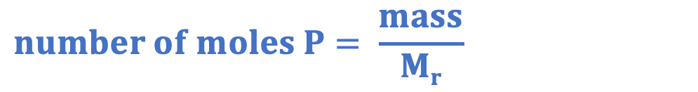
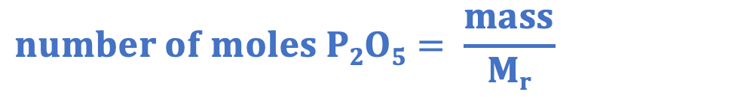
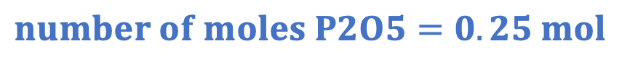
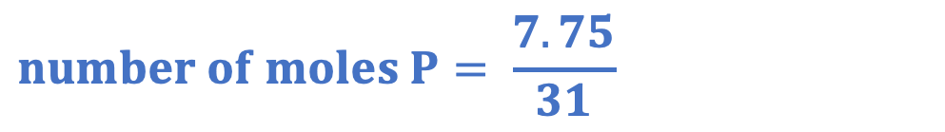
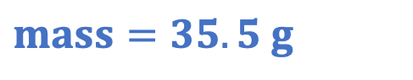
Identify the mistake(s) in this working.
4 P + 5 O₂ → 2 P₂O₅
Calculate the mass of diphosphorus pentachloride that could be made from reacting 7.75 g of phosphorus with oxygen.
$$number of moles P= \frac{mass}{Mr}$$
$$number of moles P2O5=0.25 mol$$
$$number of moles P2O5= \frac{mass}{Mr}$$
$$number of moles P= \frac{7.75}{31}$$
$$0.25 mol= \frac{mass}{142}$$
$$number of moles P=0.25 mol$$
$$mass=35.5 g$$
Notes:
This is another common mistake, where the mole ratio step has been missed.

Slide 17
Drill
State the equation that links number of moles, mass and M_{r}.
Define relative formula mass.
State the units for mass.
State the units for number of moles.
Calculate the relative formula mass of ammonia (NH₃).
Calculate the relative formula mass of sodium oxide (Na₂O).
Calculate the number of moles in 34 g of ammonia.
Calculate the number of moles in 15.5 g of sodium oxide.
Calculate the mass of 0.1 moles of ammonia.
Calculate the mass of 0.05 moles of sodium oxide.
Notes:
Purpose: This is a knowledge drill. The purpose of this is to check that the critical knowledge is secure before pupils move onto independent practice.
Suggested guidance: There are a range of ways this could be done depending on time and ability range of the class:
Mini whiteboards
As full sentences in exercise books
As short answers in exercise books
In the pupil workbook
As pair talk
As cold call

Slide 18
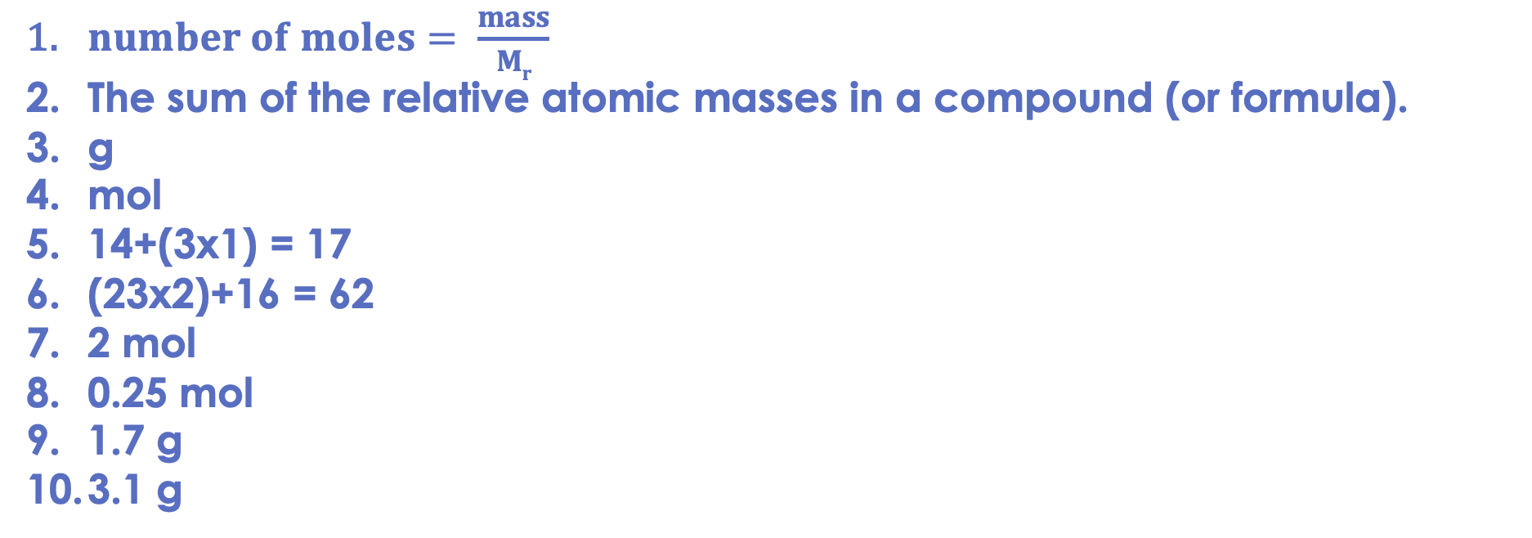
Drill answers
$number of moles= \frac{mass}{Mr}$
The sum of the relative atomic masses in a compound (or formula).
g
mol
14+(3x1) = 17
(23x2)+16 = 62
2 mol
0.25 mol
1.7 g
3.1 g
Notes:
Purpose: This is a knowledge drill. The purpose of this is to check that the critical knowledge is secure before pupils move onto independent practice.
Suggested guidance: There are a range of ways this could be done depending on time and ability range of the class:
Mini whiteboards
As full sentences in exercise books
As short answers in exercise books
In the pupil workbook
As pair talk
As cold call

Slide 19
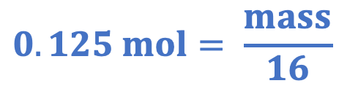
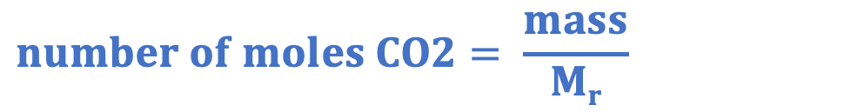
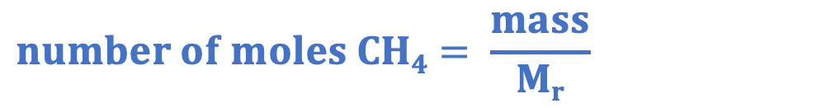
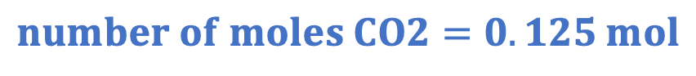
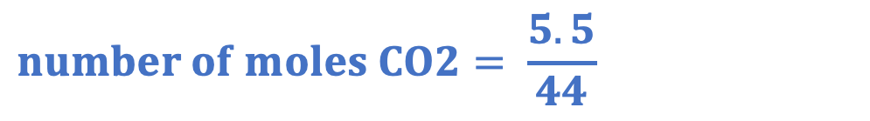
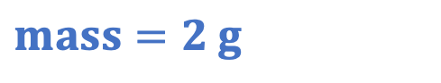
I: calculating reacting masses
CH₄ + 2 O₂ → 2 H₂O + CO₂
Calculate the mass of methane that burns to produce 5.5 g of carbon dioxide.
mole ratio = 1 : 1
$$number of moles CH4=0.125 mol$$
$$number of moles CH4= \frac{mass}{Mr}$$
$$number of moles CO2= \frac{mass}{Mr}$$
$$0.125 mol= \frac{mass}{16}$$
$$number of moles CO2= \frac{5.5}{44}$$
$$mass=2 g$$
$$number of moles CO2=0.125 mol$$
Notes:
The examples chosen for the I/We/You section provide practice working backwards from a product and with different numbers in the mole ratios. For further practice, you may want to get students to calculate masses from the reactants/products that are not calculated in these questions.
Purpose: The I-We-You section aims to support pupils to build skills that they most commonly need when answering questions associated with this knowledge in the assessment. This section is also used to interleave other content we expect pupils to know at this stage of their education in order that they build a big picture of the science they are learning.
For the ‘I’ activity, the teacher should model how to answer the question. They can do this by narrating their thinking process aloud, and making links to learning earlier in the lesson explicit.
For the ‘we’ activity, the teacher and students work though a similar example together, in order to prepare students to be able to answer a similar question independently.
Opportunities for the ‘you’ activity – independent practise – occur in the activity portion of the lesson once the student is secure enough to process independently.

Slide 20
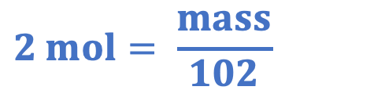
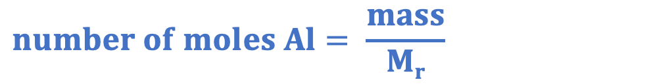
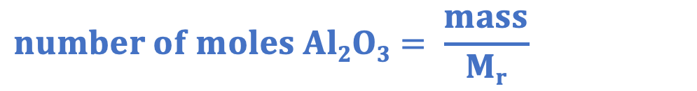
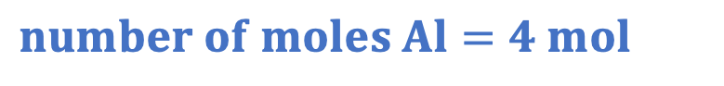
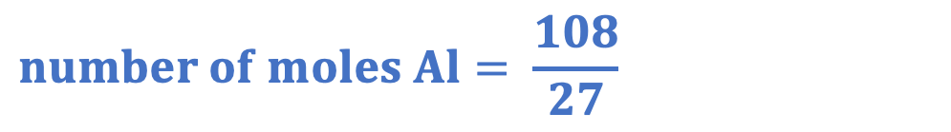
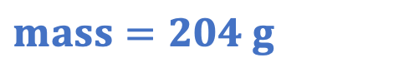
We: calculating reacting masses
Al₂O₃ + 2 Fe → Fe₂O₃ + 2 Al
Calculate the mass of aluminium oxide needed to make 108 g of aluminium.
mole ratio = 1 : 2
$$number of moles Al2O3=2 mol$$
$$number of moles Al2O3= \frac{mass}{Mr}$$
$$number of moles Al= \frac{mass}{Mr}$$
$$2 mol= \frac{mass}{102}$$
$$number of moles Al= \frac{108}{27}$$
$$mass=204 g$$
$$number of moles Al=4 mol$$
Notes:
Purpose: The I-We-You section aims to support pupils to build skills that they most commonly need when answering questions associated with this knowledge in the assessment. This section is also used to interleave other content we expect pupils to know at this stage of their education in order that they build a big picture of the science they are learning.
For the ‘I’ activity, the teacher should model how to answer the question. They can do this by narrating their thinking process aloud, and making links to learning earlier in the lesson explicit.
For the ‘we’ activity, the teacher and students work though a similar example together, in order to prepare students to be able to answer a similar question independently.
Opportunities for the ‘you’ activity – independent practise – occur in the activity portion of the lesson once the student is secure enough to process independently.

Slide 21
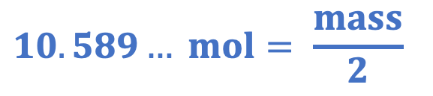
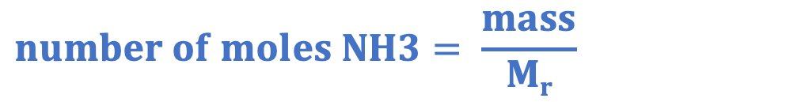
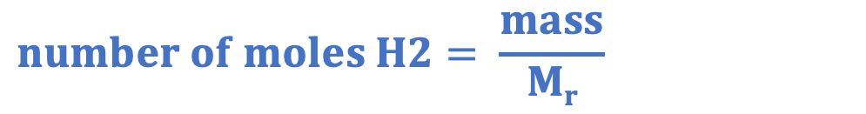
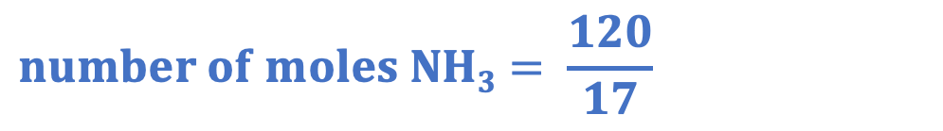
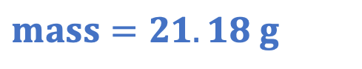
You: calculating reacting masses
N₂ + 3 H₂ → 2 NH₃
Calculate the mass of hydrogen needed to make 120 g of ammonia.
mole ratio = 3 : 2
$$number of moles H2=10.589… mol$$
$$number of moles H2= \frac{mass}{Mr}$$
$$number of moles NH3= \frac{mass}{Mr}$$
$$10.589… mol= \frac{mass}{2}$$
$$number of moles NH3= \frac{120}{17}$$
$$mass=21.18 g$$
$$number of moles NH3=7.0588… mol$$
Notes:
This example should be used to show students how to keep the number of moles on the calculator to give the most accurate final answer.
Purpose: The I-We-You section aims to support pupils to build skills that they most commonly need when answering questions associated with this knowledge in the assessment. This section is also used to interleave other content we expect pupils to know at this stage of their education in order that they build a big picture of the science they are learning.
For the ‘I’ activity, the teacher should model how to answer the question. They can do this by narrating their thinking process aloud, and making links to learning earlier in the lesson explicit.
For the ‘we’ activity, the teacher and students work though a similar example together, in order to prepare students to be able to answer a similar question independently.
Opportunities for the ‘you’ activity – independent practise – occur in the activity portion of the lesson once the student is secure enough to process independently.

Slide 22



Activity

Slide 23


Answers
1.
2. $Number of moles= \frac{mass}{Mr}$
3. The sum of the relative atomic masses of the elements in a compound or formula.
4a. 32
4b. 17
4c. 16
4d. 40
4e. 34
4f. 74

Slide 24






Answers
5a. $Number of moles= \frac{mass}{Mr}$
$$Number of moles= \frac{34}{17}$$
$$Number of moles=2 mol$$
6a. $Number of moles= \frac{mass}{Mr}$
$$0.25= \frac{mass}{16}$$
$$Mass=4 g$$
5b. $Number of moles= \frac{mass}{Mr}$
$$Number of moles= \frac{120}{40}$$
$$Number of moles=3 mol$$
6b. $Number of moles= \frac{mass}{Mr}$
$$0.75= \frac{mass}{34}$$
$$Mass=25.5 g$$
5c. $Number of moles= \frac{mass}{Mr}$
$$Number of moles= \frac{100}{74}$$
$$Number of moles=1.35 mol$$
6c. $Number of moles= \frac{mass}{Mr}$
$$0.1= \frac{mass}{32}$$
$$Mass=3.2 g$$

Slide 25


Answers
7a. Dissolved in solution
8a. Melted, in liquid state
7b. $Number of moles Mg= \frac{mass}{Mr}$
$$Number of moles Mg= \frac{50}{24}$$
$$Number of moles=2.083… mol$$
Mole ratio = 1:2
$$Number of moles MgCl2=4.166… mol$$
$$Number of moles MgCl2= \frac{mass}{Mr}$$
$$4.166…mol= \frac{mass}{95}$$
$$Mass=395.83 g$$
8b. $Number of moles Ti= \frac{mass}{Mr}$
$$Number of moles Ti= \frac{800}{48}$$
$$Number of moles=16.666… mol$$
Mole ratio = 1:1
$$Number of moles TiCl4=16.666… mol$$
$$Number of moles TiCl4= \frac{mass}{Mr}$$
$$16.666…mol= \frac{mass}{190}$$
$$Mass=3 166.67 g$$

Slide 26

Answers
9a. $Number of moles C3H8= \frac{mass}{Mr}$
$$Number of moles C3H8= \frac{250}{44}$$
$$Number of moles C3H8=5.6818… mol$$
Mole ratio = 1:3
$$Number of moles CO2=17.045… mol$$
$$Number of moles CO2= \frac{mass}{Mr}$$
$$17.045…mol= \frac{mass}{44}$$
$$Mass=750 g$$
9b. Otherwise the gas would escape, and it would not be possible to measure its mass.

Slide 27

Answers
10c. It has to be heated to a very high temperature to make it molten, so the ions can flow through the liquid and conduct electricity.
10a. (27x2)+(3x16) = 102
10b. $Number of moles Al= \frac{mass}{Mr}$
$$Number of moles Al= \frac{1000}{27}$$
$$Number of moles=37.037… mol$$
Mole ratio = 2:4
Mole ratio = 1:2
$$Number of moles Al2O3=18.5185… mol$$
$$Number of moles Al2O3= \frac{mass}{Mr}$$
$$18.5185…mol= \frac{mass}{102}$$
$$Mass=1 888.89 g$$
10d. O²⁻ ions would be attracted to the positive electrode, where they would be oxidized (lose two electrons) to form oxygen atoms, which would be released as a diatomic gas.
10e. 2 O²⁻ → O₂ + 4 e⁻
10f. Electrolysis is an expensive process as compounds need to be molten and it uses a lot of energy to heat them past their melting point. Less reactive metals can be extracted using reduction with carbon.

Slide 28
Answer the questions below.
2 Mg + O₂ → 2 MgO
12 g of magnesium burns in oxygen. Calculate the number of moles of magnesium that reacted.
A. 12 mol
B. 2 mol
C. 0.5 mol
✓
Calculate the number of moles of oxygen that would have reacted.
A. 1.0 mol
B. 0.5 mol
C. 0.25 mol
✓
Calculate the mass of oxygen that would have reacted.
A. 4 g
B. 8 g
C. 128 g
✓
Notes:
For this exit ticket, it is worth showing going through the answer to each question before starting the next question to reduce errors carried forward.
Q1. Answer: C
If students answer A, they are not clear on the different between mass and number of moles. If students answer B, they have divided Mr by mass, which is a common error when students assume it is ‘big number over small number’. To fix it, review the equation that links number of moles, mass and Mr and give students lots of practice calculations.
Q2. Answer: C
If students answer A, it shows they have recognised there is a 2:1 mole ratio but have got this the wrong way round. If students answer B, they have not recognised there is a 2:1 mole ratio and have assumed there is the same number of moles of each. To fix it, review mole ratios from balanced chemical equations.
Q3. Answer: B
If students answer A, they have used the Ar of oxygen not the Mr. To fix it, review the meaning of Mr and Ar and get students to practice calculating the Mr of some diatomic elements. If students answer C, they have used the correct Mr of oxygen but have divided Mr by number of moles rather than multiplying. To fix it, review the equation that links number of moles, mass and Mr.

Slide 29
Lesson C4.3.7
What was good about this lesson? | What can we do to improve this lesson?
Send us your feedback by clicking this link
or by emailing sciencemastery@arkonline.org
Thank you!

